Slide 1
DATA ANALYTICS PROJECT
Airbnb London
Market Analysis, Price Prediction & Sentiment Analysis
Python • Machine Learning • NLP • Power BI
Presented by:
Priyanka.R
B.Tech Information Technology
SRM Valliammai Engineering College

Slide 2
Problem Statement & Objectives
What this project set out to answer?
PROBLEM
Airbnb hosts, guests, and platform analysts have limited visibility into what actually drives nightly pricing, guest satisfaction, and listing availability across a fragmented market like London — making it hard to price competitively or spot underperforming segments.
OBJECTIVES
01
02
03
04
Explore pricing patterns
Predict nightly price
Quantify guest sentiment
Deliver an interactive dashboard
across boroughs, room types, and bedroom counts
using listing attributes with ML regression models
from review text at scale using NLP
for stakeholders to explore findings live
2

Slide 3
Dataset & Tools Used
What went into the analysis
DATASET
TOOLS & LIBRARIES
Source
Python
pandas, numpy — data cleaning & numerical operations
Inside Airbnb — London listings snapshot (2019)
Visualization
matplotlib, seaborn, folium — EDA & geospatial plots
Listings
9,230 cleaned records across 32 boroughs, 45+ features
Machine Learning
scikit-learn — Linear Regression, Random Forest
Reviews corpus
1.7M+ guest review comments for sentiment analysis
NLP
NLTK (VADER) — sentiment scoring on review text
Geodata
Latitude/longitude for every listing (used in map + spatial EDA)
Dashboard
Power BI Desktop — interactive dashboard with slicers
3

Slide 4
Project Methodology
End-to-end process, from raw data to dashboard
1
2
3
4
5
6
Data Collection
Data Cleaning
Exploratory
Analysis
Predictive
Modeling
Sentiment
Analysis
Dashboard
Build
Raw listings and review data were pulled from Inside Airbnb, cleaned and de-duplicated in pandas, explored visually to surface pricing patterns, then used to train two regression models and run NLP sentiment scoring — with every finding surfaced in a single interactive Power BI dashboard.
4

Slide 5
Data Preparation & EDA
Cleaning steps and what the exploratory analysis revealed
DATA PREPARATION
EDA HIGHLIGHTS
Dropped columns with >50% missing values
Neighbourhood pricing
Central boroughs (City of London, Kensington) command the highest average nightly rates
Imputed numeric fields with median, categorical with “Unknown”
Room type mix
Entire homes and private rooms make up nearly the entire market
Converted price strings (“$120.00”) to clean numeric values
Price vs. reviews
Removed price outliers using the IQR method
Weak relationship — expensive listings aren’t reviewed more often
Parsed review dates to datetime; removed duplicate rows
Availability
Most listings cluster at low or very-high availability, few sit in the middle
5

Slide 6
Machine Learning & Sentiment Analysis
Price prediction models and NLP-based review sentiment
PRICE PREDICTION — MODEL COMPARISON
SENTIMENT ANALYSIS (NLTK VADER)
Model
MAE (£)
RMSE (£)
R² Score
Linear Regression
44.44
55.75
0.065
Random Forest
40.74
53.05
0.153
✓ Random Forest outperforms Linear Regression, but both R² scores are modest — price is influenced by factors beyond these 5 features (esp. location).
Top predictive features: reviews/month (25.4%) and availability_365 (25.1%)
86.1% of 1.7M+ analyzed reviews are Positive — guest satisfaction is overwhelmingly high across the platform.
6

Slide 7
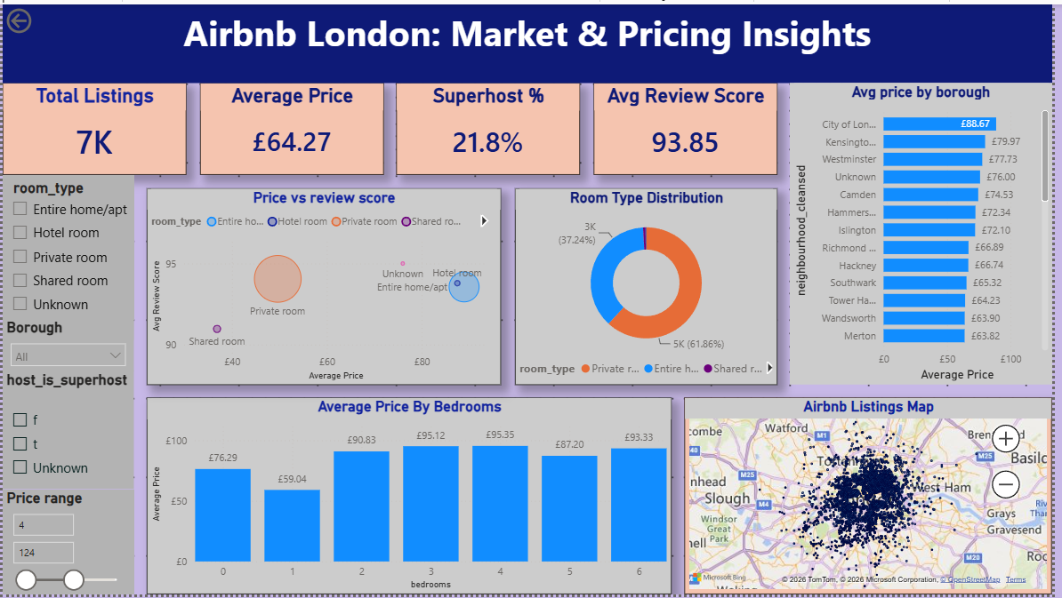
Power BI Dashboard
Interactive dashboard with live cross-filtering, slicers, and map
DASHBOARD FEATURES
4 KPI cards — listings, price, superhost %, review score
Room type, borough, superhost & price-range slicers
Cross-filtering across every visual on the page
Avg price by borough, room type split, price by bedrooms
Live geospatial map of all 9,230 listings
7

Slide 8
Key Insights
What the data actually tells us
01
02
03
Location is the #1 price driver
Guests are overwhelmingly satisfied
Price barely predicts satisfaction
City of London (£155/night) prices nearly 4x higher than Bexley (£41/night).
86.1% of 1.7M+ reviews score Positive on sentiment — only 4.2% Negative.
Price vs. review score correlation is effectively zero (−0.001).
04
05
06
ML price prediction has room to grow
Superhosts outperform on service, not price
The market is nearly split in two
Random Forest’s R² of 0.153 shows non-location features alone explain little of price — confirming location matters most.
96.4 avg review score vs. 93.1 for others — while charging £9 less per night.
Private rooms (51%) and entire homes (48%) make up almost all listings.
8

Slide 9
Conclusion & Future Scope
What we learned, and where this project could go next
CONCLUSION
London’s Airbnb market is overwhelmingly shaped by location and property type rather than review quality, and guest sentiment is highly positive platform-wide. The current price-prediction models confirm this: without location as a direct feature, they explain only a modest share of price variance — a clear signal that geography is the dominant factor.
FUTURE SCOPE
Add location features
Try advanced models
Seasonal trend analysis
Topic modeling on negatives
Encode borough/coordinates directly to boost model R²
XGBoost / gradient boosting with hyperparameter tuning
Time-series pricing patterns across the calendar year
Surface common complaint themes from Negative reviews
9

Slide 10
Thank You

